Slide 2
Summertraning
Nikhil Vemulpalli

Slide 3
CONTENTS
Introduction
Data structure
Asymptotic Notations
Project
Conclusion

Slide 4
INTRODUCTION
Data Structures and Algorithms (DSA) are fundamental concepts in computer science and programming that play a pivotal role in solving complex computational problems efficiently. DSA is a combination of two key components:
.

Slide 5
Data Structures: These are specialized formats for organizing and storing data. Data structures provide a way to efficiently store, retrieve, and manipulate data. Common examples include arrays, linked lists, stacks, queues, trees, graphs, and hash tables. The choice of data structure depends on the specific problem and the operations that need to be performed on the data.
Algorithms: Algorithms are step-by-step procedures or sets of rules for performing specific tasks or solving particular problems. They define how data is processed, transformed, and manipulated within data structures to produce the desired output. Algorithms can be simple, like sorting a list of numbers, or highly complex, like routing data in a network or searching for patterns in large datasets.
.

Slide 6
- Efficiency: DSA focuses on designing data structures and algorithms that optimize various aspects of computation, such as time complexity (how long an algorithm takes to run) and space complexity (how much memory it requires). Efficient DSA is essential for improving the performance of software applications.
- Problem Solving: DSA provides a systematic approach to problem-solving. It enables programmers and computer scientists to analyze, design, and implement solutions to real-world problems effectively.
- Foundation of Computer Science: DSA forms the foundation of many computer science subfields, including artificial intelligence, database management, operating systems, and more. Understanding DSA is crucial for a strong grasp of computer science principles.
.

Slide 7
Programming Interviews: DSA knowledge is often a requirement for technical job interviews, especially for roles in software development and engineering. Interviewers assess a candidate's ability to solve complex problems by evaluating their DSA skills.
- Portability: DSA concepts are not tied to any specific programming language or platform. They can be applied across a wide range of programming languages and environments.
In summary, Data Structures and Algorithms are fundamental concepts that every programmer and computer scientist should understand. They empower individuals to write efficient code, solve complex problems, and build robust software applications. Mastery of DSA is a cornerstone of success in the world of computer science and programming.
.

Slide 8
Data structures
There are several Data structures to store and work on the data

Slide 9
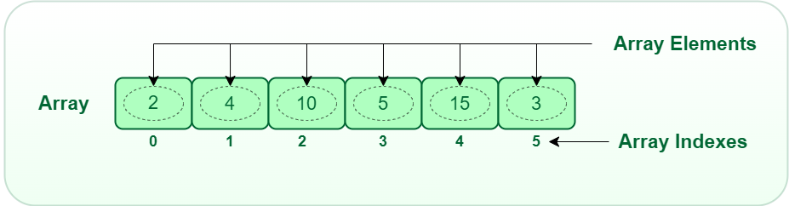
ARRAY
An array is a collection of items of same data type stored at contiguous memory locations. For simplicity, we can think of an array as a flight of stairs where on each step is placed a value Here, you can identify the location of any of your friends by simply knowing the count of the step they are on. This makes it easier to calculate the position of each element by simply adding an offset to a base value, i.e., the memory location of the first element of the array. The base value is index 0 and the difference between the two indexes is the offset.

Slide 10
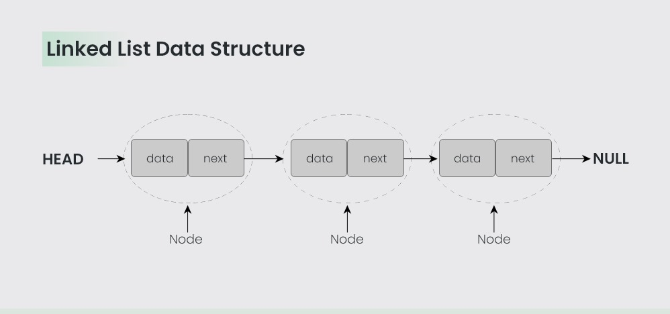
Linked list
A linked list is a linear data structure, in which the elements are not stored at contiguous memory locations. The elements in a linked list are linked using pointers. Each node contains a data item and a reference (in the form of a pointer) to the next node in the sequence. A linked list consists of a data element known as a node

Slide 11
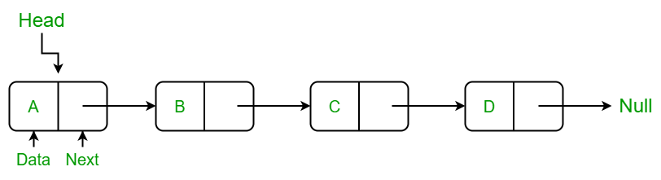
Singly Linked List
A singly linked list is a type of linked list that is unidirectional, that is, it can be traversed in only one direction from head to the last node (tail). Each element in a linked list is called a node. A single node contains data and a pointer to the next node which helps in maintaining the structure of the list.

Slide 12
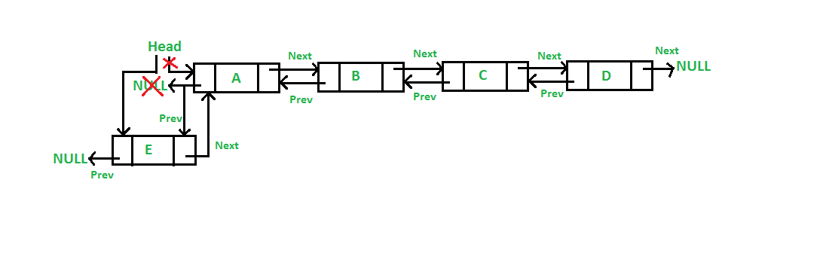
Double Linked List
Inserting a new node in a doubly linked list is very similar to inserting new node in linked list. There is a little extra work required to maintain the link of the previous node. Doubly Linked List is a variation of Linked list in which navigation is possible in both ways, either forward and backward easily as compared to Single Linked List.

Slide 13
Circular linked list
The circular linked list is a linked list where all nodes are connected to form a circle. In a circular linked list, the first node and the last node are connected to each other which forms a circle. There is no NULL at the end. In a circular linked list, the first node and the last node are connected to each other which forms a circle. There is no NULL at the end.

Slide 14
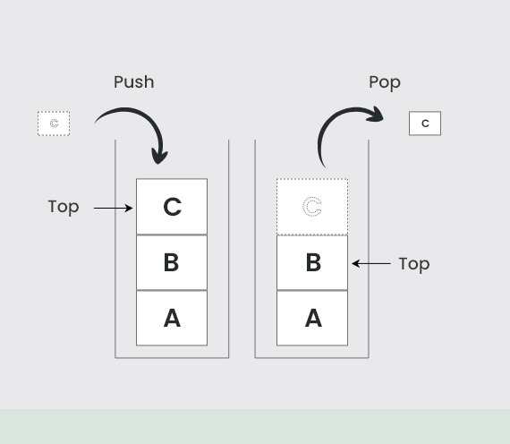
Stack
Stack is a linear data structure that follows a particular order in which the operations are performed. The order may be LIFO(Last In First Out) or FILO(First In Last Out). LIFO implies that the element that is inserted last, comes out first and FILO implies that the element that is inserted first, comes out last. A real-life example is a stack of plates

Slide 15
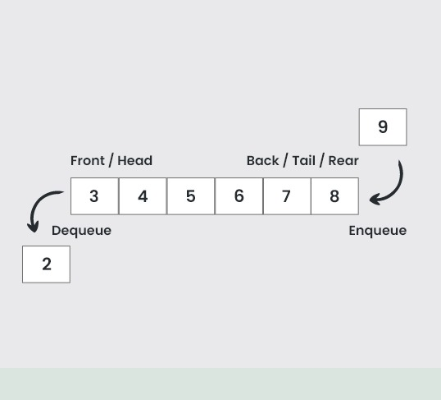
QUEuE
A Queue is defined as a linear data structure that is open at both ends and the operations are performed in First In First Out (FIFO) order. queue to be a list in which all additions to the list are made at one end, and all deletions from the list are made at the other end. The element which is first pushed into the order, the operation is first performed on that.

Slide 16
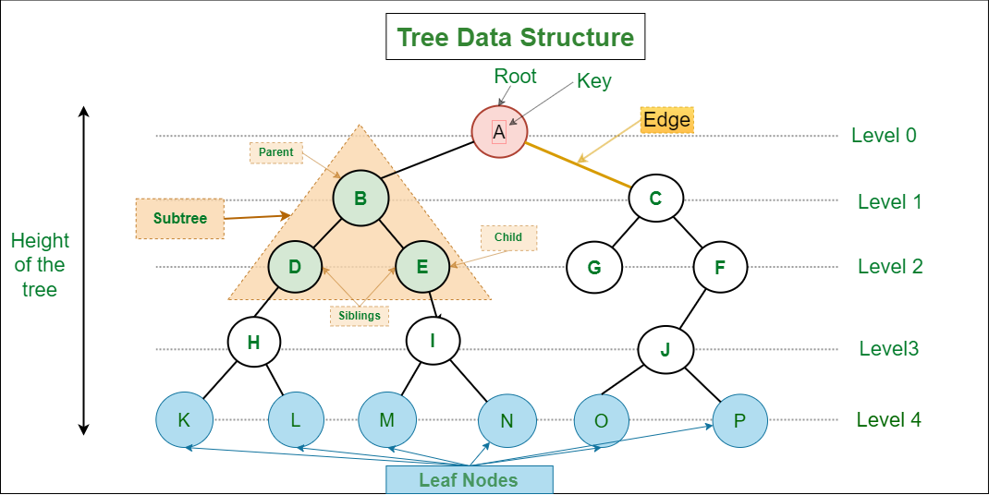
TREE
This data structure is a specialized method to organize and store data in the computer to be used more effectively. It consists of a central node, structural nodes, and sub-nodes, which are connected via edges. We can also say that tree data structure has roots, branches, and leaves connected with one another.

Slide 17
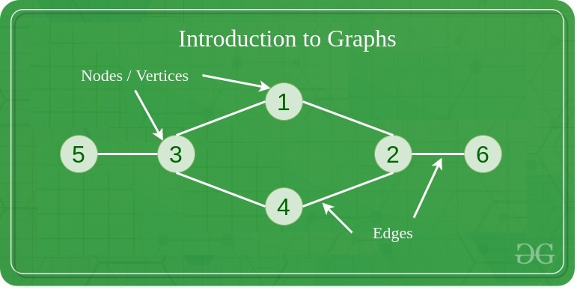
GRAPH
A Graph is a non-linear data structure consisting of vertices and edges. The vertices are sometimes also referred to as nodes and the edges are lines or arcs that connect any two nodes in the graph. More formally a Graph is composed of a set of vertices( V ) and a set of edges( E ). The graph is denoted by G(E, V).

Slide 18
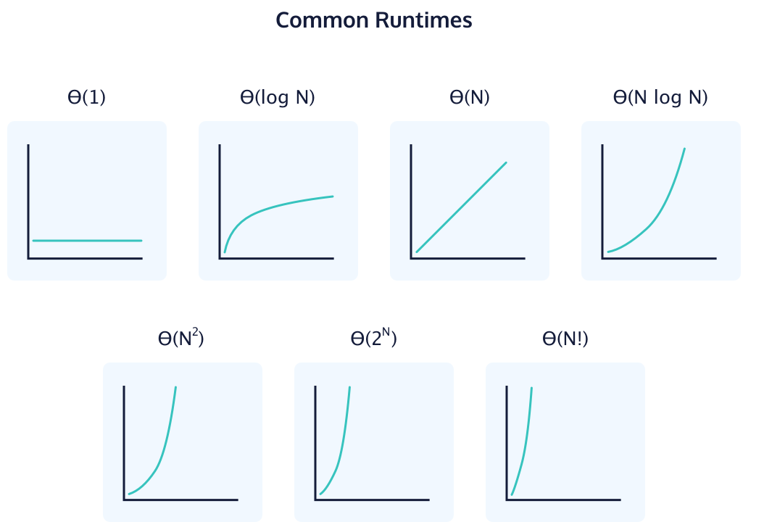
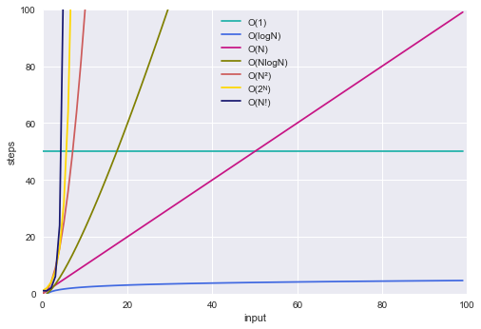
Asymptotic Notations
Big-Θ Notation
We compute the big-Θ of an algorithm by counting the number of iterations the algorithm always takes with an input of n. For instance, the loop in the pseudo code below will always iterate N times for a list size of N. The runtime can be described as Θ(N).
These are the representations the complexity.
Big-O Notation
The Big-O notation describes the worst-case running time of a program. We compute the Big-O of an algorithm by counting how many iterations an algorithm will take in the worst-case scenario with an input of N. We typically consult the Big-O because we must always plan for the worst case. For example, O(log n) describes the Big-O of a binary search algorithm.

Slide 19
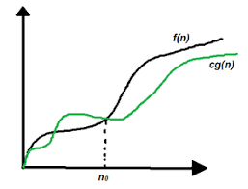
Big-Θ Notation
We compute the big-Θ of an algorithm by counting the number of iterations the algorithm always takes with an input of n. For instance, the loop in the pseudo code below will always iterate N times for a list size of N. The runtime can be described as Θ(N).
Big-O Notation
The Big-O notation describes the worst-case running time of a program. We compute the Big-O of an algorithm by counting how many iterations an algorithm will take in the worst-case scenario with an input of N. We typically consult the Big-O because we must always plan for the worst case. For example, O(log n) describes the Big-O of a binary search algorithm.

Slide 20
Big-Θ Notation
We compute the big-Θ of an algorithm by counting the number of iterations the algorithm always takes with an input of n. For instance, the loop in the pseudo code below will always iterate N times for a list size of N. The runtime can be described as Θ(N).
Big-Ω Notation
Big-Ω (Omega) describes the best running time of a program. We compute the big-Ω by counting how many iterations an algorithm will take in the best-case scenario based on an input of N. For example, a Bubble Sort algorithm has a running time of Ω(N) because in the best case scenario the list is already sorted, and the bubble sort will terminate after the first iteration.

Slide 21
flight management system
-DSA(in “c++”)

Slide 22
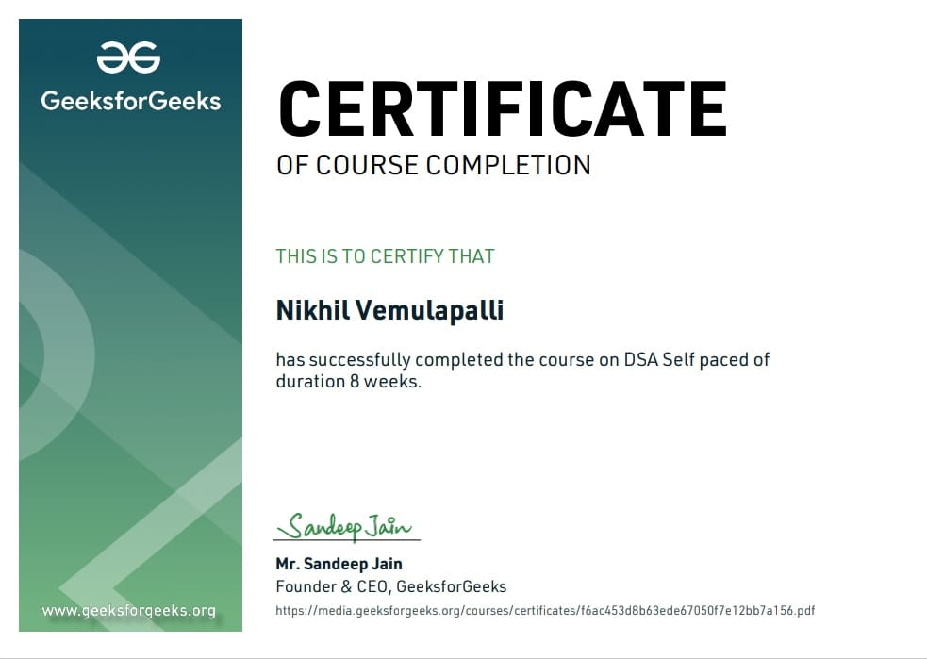

Slide 23
SUMMARY
Here is a summery of a Flight Management System DSA project A Flight Management System(FMS)implemented as a Data Structures and Algorithms(DSA)project is designed to efficiently manage the operations and data associated with the flight. Such a system is essential for to add customer details, for flight reservation, for tickets and charges.

Slide 24
THANK YOU
Nikhil Vemualaplli
Reg-no:12114413

